Slide 1
Date: 21-05-2024
PROJECT
PRESENTATION
COURSE: IRE 106 : ELECTRONICS DEVICES AND APPLICATIONS SESSIONAL
Presenter:
Supervisor:
Mehrin Farzana(2101013)
Maria Jahan Mim(2101022)
Ismot Ara(2101027)
Sadia Islam Mou(2101028)
Dept. of IRE, BDU
2021-22
Sadia Enam
Lecturer
Dept. of IRE
BDU

Slide 2
PROJECT TITLE:
SMART SOUND ACTIVATED SWITCH WITH SOUND INTENSITY SENSITIVITY

Slide 3
01
PROJECT INTRODUCTION
02
PROJECT OBJECTIVE
contents
03
APPLICATIONS
04
PROJECT DEVELOPMENT TIMELINE
05
PROJECT PRESENTATION
06
RESULTS
07
FUTURE ENHANCEMENTS
08
ACKNOWLEDGEMENTS
09
CONCLUSION

Slide 4
01
PROJECT INTRODUCTION
Welcome to our project presentation on the Smart Sound Activated Switch with Sound Intensity Sensitivity. The project integrates electrical componets with programming. In this project, we aimed to develop a sound activated switch with voltage regulation feature with sound level. This project aims to demonstrate the integration of electrical components and smart processing with programming.

Slide 5
02
PROJECT OBJECTIVE
Design and construct a sound activated switch with sound level controlled volatge regulator
learn about the necessary electronics components
Integrate the materials with pre-developed ICs
Use programming knowledge to smartly control the output against the input
Debug and optimize

Slide 6
03
APPLICATIONS
Traffic sound monitor
Visually represent how much of sound is generated by each vehicle
Visually represent which roads are more sound polluted
Industrial sound monitor
Visually represent each industrial sound level
Home automation system
Zero touch home appliance switch
Zero touch home appliance power suply regulator
Entertainment system
Light show with music production
Sound equioment testing

Slide 7
04
PROJECT DEVELOPMENT TIMELINE
Task | Start Date | End Date | Duration | Progress
Simulation | 2/10/2024 | 2/10/2024 | 1 | Done
Arduino code | 2/10/2024 | 2/10/2024 | 1 | Done
Hardware setup | 3/24/2024 | 4/5/2024 | 12 | Done
Integration | 3/24/2024 | 4/5/2024 | 12 | Done
Testing and debugging | 4/5/2024 | 4/15/2024 | 10 | Done
Documentation | 2/10/2024 | 4/15/2024 | 65 | Done

Slide 8
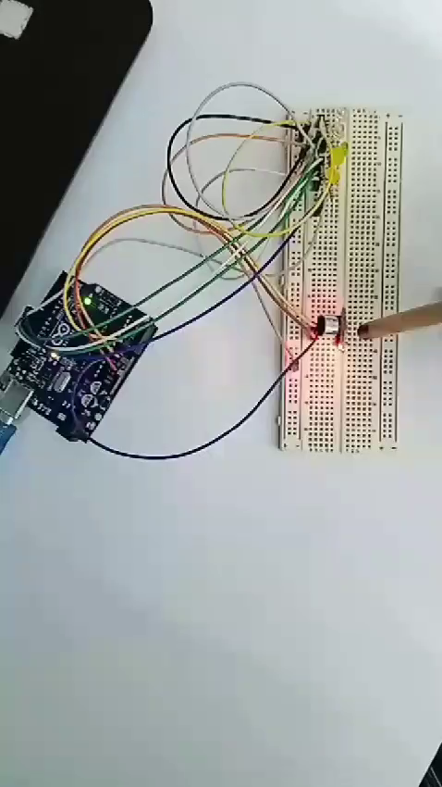
05
PROJECT PRESENTATION
The project uses,
An analogue sound sensor
A microcontroller, Arduino UNO
5 LEDs for output visualization
Breadboard for circuit base
Jumper wires for connection
Input voltage | LED1 status | LED2 status | LED3 status | LED4 status | LED5 status
>555 & <558 | ON | OFF | OFF | OFF | OFF
>558 & <560 | ON | ON | OFF | OFF | OFF
>560 & <562 | ON | ON | ON | OFF | OFF
>562 & <564 | ON | ON | ON | ON | OFF
>564 | ON | ON | ON | ON | ON

Slide 9
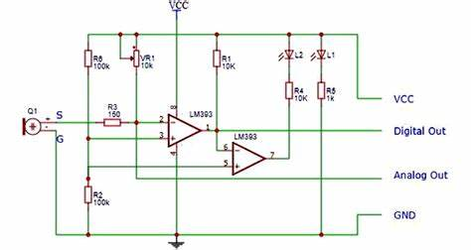
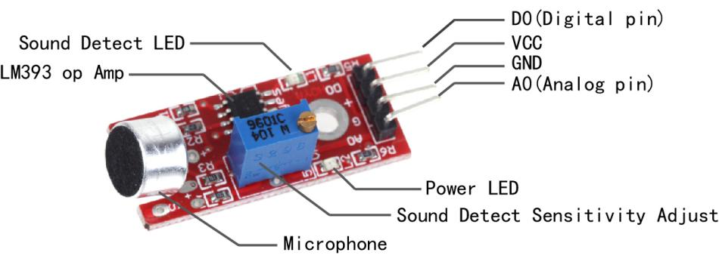
05
PROJECT PRESENTATION
Why we were able to use an analogue sound sensor,
Fig. 1: Analogue sound sensor circuit diagram and pinout

Slide 10
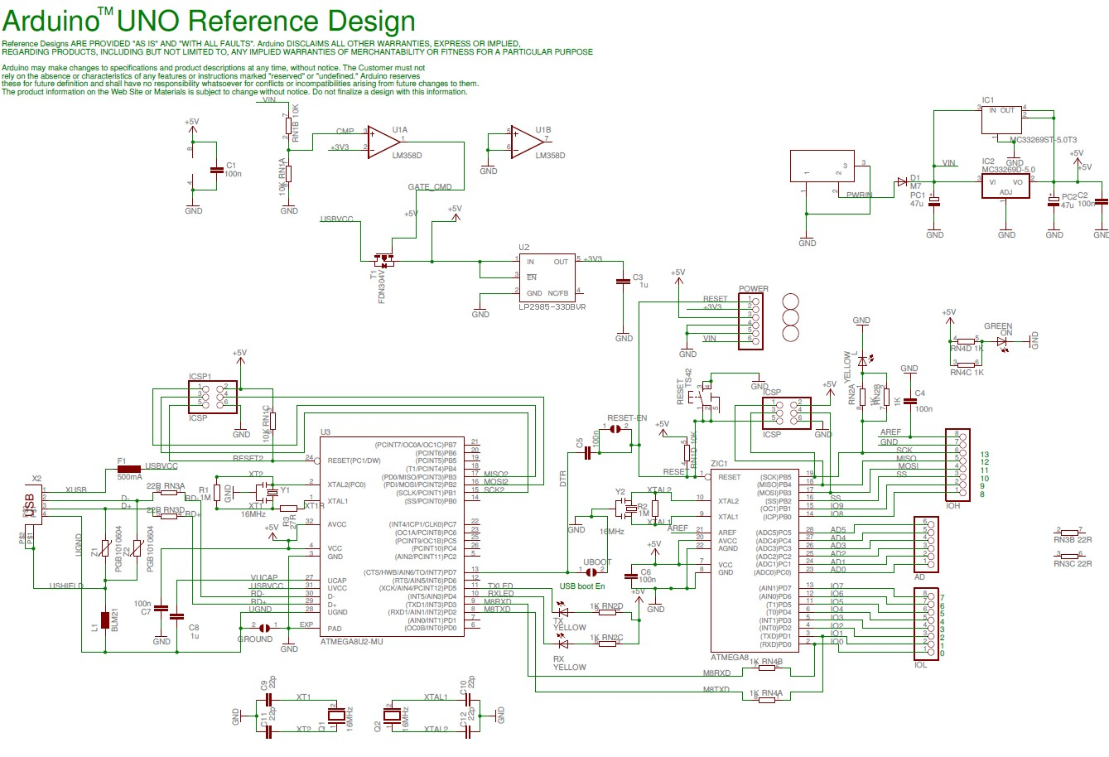
05
PROJECT PRESENTATION
Why we were able to use a microcontroller, Arduino UNO
Fig. 2: Arduino circuit diagram

Slide 11
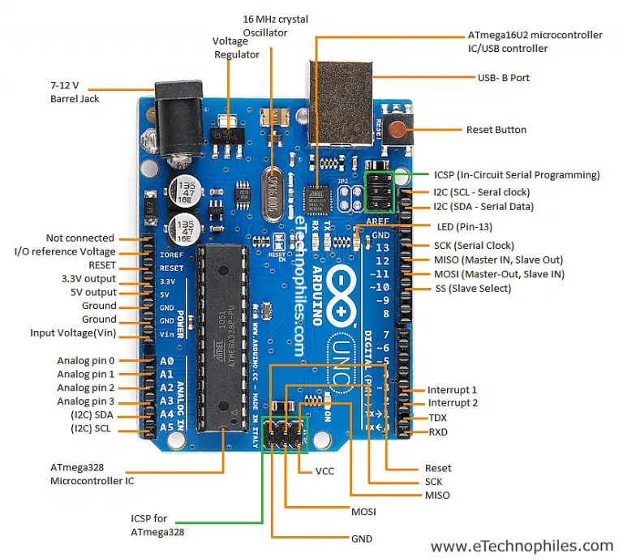
05
PROJECT PRESENTATION
Why we were able to use a microcontroller, Arduino UNO
Fig. 3: Arduino UNO components

Slide 12
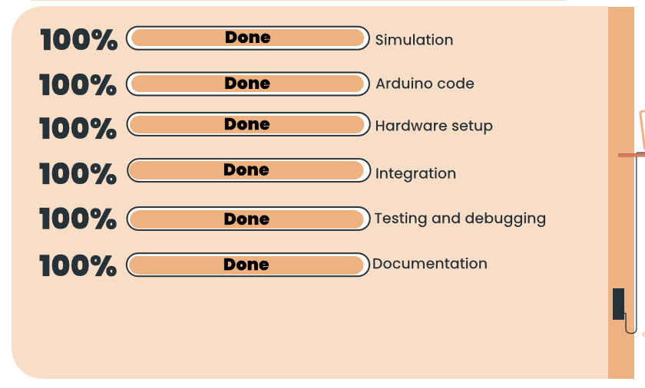
06
RESULTS

Slide 13
07
FUTURE ENHANCEMENTS
Potential enhancements for the project include:
Adding advanced sensors for noise cancelation.
Implementing more sophisticated control algorithms for smoother and more precise regulation.
Expanding the control over more devices.
Enhancing the mechanical design for greater load capacity and versatility.

Slide 14
08
ACKNOWLEDGEMENTS
We would like to express our gratitude to our project supervisor, [Sadia Enam], for her guidance and support throughout this project. We also thank [Bangabandhu Sheikh Mujibur Rahman Digital University, Bangladesh] for partially providing the resources and facilities necessary for the completion of this project.

Slide 15
08
CONCLUSION
The Smart Sound Activated Switch With Sound Intensity Sensitivity project demonstrates the effective integration of electricals components such as OpAmps, Diodes, Transistors etc. This project not only achieves its initial objectives but also sets the stage for future innovations in the field of zero touch switches and regulators. The successful implementation and testing of the system validate its potential for real-world applications, marking a significant step forward in the development of versatile and efficient non-contact device powering solutions.

Slide 16

THANK YOU!
https://circuitdigest.com/microcontroller-projects/interfacing-sound-sensor-with-arduino

